Slide 1
Karnaugh-Map

Slide 2
Simplification of Boolean Functions using K-Maps

Slide 3
Introduction
Is a pictorial form of a truth table or as an extension of the Venn diagram
First proposed by Veitch and slightly modified by Karnaugh
Also known as Veitch diagram or Karnaugh Map.
Each square in K-map represents one minterm.

Slide 4
Two variable Map
Three variable Map

Slide 5
4-variable K-Map

Slide 6
Example 1
Simplify the Boolean function
F = Σ(2,3,4,5)

Slide 7
Example 2

Slide 8
Example 1

Slide 9
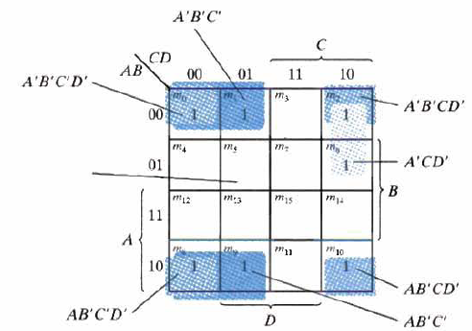
Example 2

Slide 10
Karnaugh-Map

Slide 11
Prime Implicant
A prime implicant is a product term obtained by combining the maximum possible number of adjacent squares in the map
If a minterm in a square is covered by only one prime implicant, that prime implicant is said to be essential

Slide 12
Example

Slide 13
Product of Sum Simplification

Slide 14
Procedure to find POS
Map 0’s.
2 ways
If Map is represented using minterms, when you map 0’s, you will get F′ in SOP form. Take the complement which gives you F in POS form.
Represent the map using MAX terms. So, directly you will get expression F in POS form

Slide 15
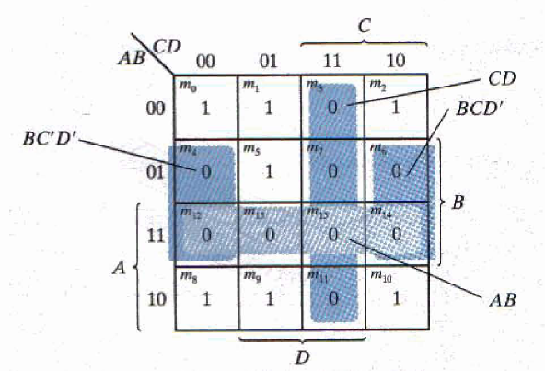
Example
F(A, B, C, D) = Σ (0, 1, 2, 5, 8, 9, 10)
F′ = AB + CD + BD′
F = (A′ + B′)(C′ + D′)(B′ + D)

Slide 16
Example
Obtain the function F = Σ(0, 1, 2, 4, 6, 8, 9, 10) in POS form
(C+D) (C+D′) (C′+D′) (C′+D)
A + B
A + B′
A′ + B′
A′ + B
0
0
0
0
0
0
0
0
F = (A′ + B′)(C′ + D′)(B′ + D′)

Slide 17
References
M.Morris Mano, Michael D. Ciletti, “Digital Design”, 4e, 2007

